Slide 1
Transitions with Acute Illness
Sandy O’ Brien RN MN CL ACM CDP
HARBOR TRANSITIONS LLC

Slide 2
Disclaimer
Please note I am providing this information based upon general information, research, education and experience.
I am not here to represent any hospital system or managed care affiliation.
I am here as the Owner and Provider for Harbor Transitions LLC.

Slide 3
Transitions
Transition of Care – The movement of a patient from one setting of care (hospital, ambulatory primary care practice, ambulatory specialty care practice, long-term care, home health, rehabilitation facility, one different living environment) to another.
(Care Management Description)

Slide 4
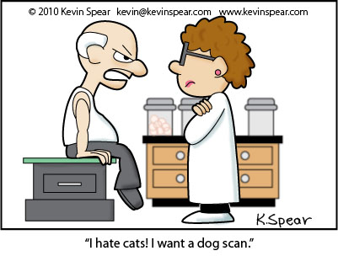
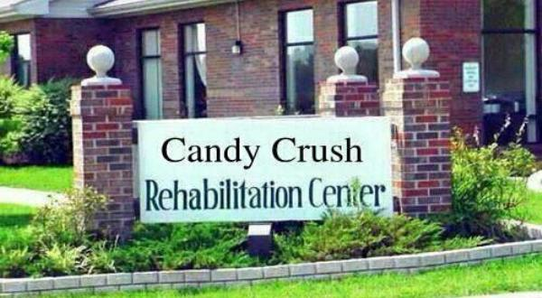
.

Slide 5
The Phases of Transitional Care with Acute Illness in the Aging Population
Pre-Hospital
In Hospital
Post Hospital

Slide 6
Transitions occur within all Three Transitional Stages
Wellness to Illness
Independent to Dependent
Familiar to Unfamiliar
Financial Freedom to Restrictions
Established Role to New and Sometimes Confused Role
Child to Parent
Parent to Child
Control to No-control or Limited Control
Certain to Uncertain
Calm to Fear /Behaviors

Slide 7
How do these Transitions Impact the Individual, Families and Service Providers?
The Good
The Bad
The Ugly

Slide 8
Upstream –Downstream Management
The best way to manage is to manage Upstream in the Pre-Hospital, Outpatient Setting.
With the Goal being to Avoid Hospital Admissions and ED visits whenever possible and/or being as prepared as possible for those Transitions and Experiences.

Slide 9
Pre-Hospital
Communicate and Organize
Document and Documents*
Stay Current, Keep things updated
Amend as needed
Develop Collaborative Relationships with Primary Care and Specialists*
Monitor and be Proactive
Have a Hospital/ED Plan and Commitments*

Slide 10
Documents:
Address where they are from, contact information, back up numbers.
Advanced Directives
Medication Lists
Care Plan(s) with information regarding likes, dislikes, habits, and other information that might make experience easier for them (i.e. sleeping habits, eating habits, bathroom, fears, triggers)
Provider Information and Contact Information

Slide 11
Relationship with Outpatient Providers
Ask about after hour services and how timely they are in responding.
Ask about how fast Patient can be seen if concerned.
Ask about Urgent Care Options.
Ask about possible lab tests for suspected UTIs. Approaches to Pain? Acute/Chronic
Ask if they want to know if their patient has been admitted and if they do, be sure to let them know.

Slide 12
Hospital/ED Plan and Commitments
Who to call, how will call chain work.
How to Transport or who will transport.
Who will be liaison how will communication be shared.
Who will be decision makers.
Who will organize visiting and stay with patient if indicated.
What will be in patient’s “hospital bag”?

Slide 13
While In Hospital
For E.D. – Have a plan
Call ahead if possible. Void/Meds before if appropriate.
Make sure you have or send information, and have copies to give to floors.
Realize it may be hours of waiting. Provide for comfort and support. (music, headsets, tablets, tactile comfort, read, limit visitors)
Ask: Observation versus Inpatient Status?*

Slide 14
While In Hospital (cont.)
While on floor:
Follow plan for ED visit, in addition make sure if possible, to have someone with them in the late afternoon to early evening. Be creative with efforts to make the feel safe and comfortable.
Make sure the floor(s) have a copy of paperwork and all necessary information including patient specific information for Continuity of Care and Care Planning.
It is OK to advocate and ask questions
Ask to be informed of Care Planning
Make contact with Care Manager.
Advise Care Manager of resources for transportation, etc.

Slide 15
Components
Patient
Care Manager*
Family/POA
LTC Facility/Home
Provider(s)
Doctor/Nurses, Therapies

Slide 16
Care (Case) Managers
Role of Care Manager, Social Worker or RN
Assess for Needs, Status, Resources
Coordinate, Communicate and Plan
Orchestrate and Organize Discharges
Support and Educate
Resource Management
How you can best collaborate/communicate?

Slide 17
Post Hospital
Closely review the medication instructions and list.
Be sure to coordinate follow-up instructions as directed
Monitor for signs of worsening, lack of improvement or other problems.
Be extra careful of the potential for falls and injury. They may have become deconditioned, have medication reactions, have some hydration issues, lack of sleep or other problems.
Contact the Primary Care Provider to let them know the patient has returned or has gone to Post Acute Care for continued services.
Communicate and use same interventions with the Post Acute Care Facility that you did while in the hospital.

Slide 18
Role of RN Coach/Consultant
Certified Care Managers specialize in the needs of the Aging Population at Home and as they go through Transitional Experiences.
Provide In-home or On-site Comprehensive Assessments.
Develop Individualized Care Plans.
Monitor for Health Care Needs and Educate.
Coordinate and Communicate with Family and Friends as desired and indicated.
Act as Liaison with Health and Service Providers.
Provide Advocacy in conjunction with Client desires and best interest.

Slide 19
Thank you
LLC
Sandy O’Brien RN MN Consultant
Certified Case Manager (ACM)
Certified Dementia Practitioner (CDP)
Certified Alzheimer’s Disease and Dementia Trainer (CADDT)
WA State Certified Counselor (CL)
Certified Professional Coach (CPC)
sandy@harbortransitions.com
www.harbortransitions.com
253-442-9242

